Slide 1

Presented By
Bijay Kumar Pradhan

Slide 2

Case Study Presentation
Hotel Management System

Slide 3

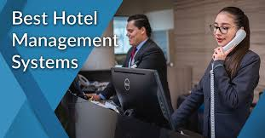


Let’s Know about → Hotel Management System

Slide 4
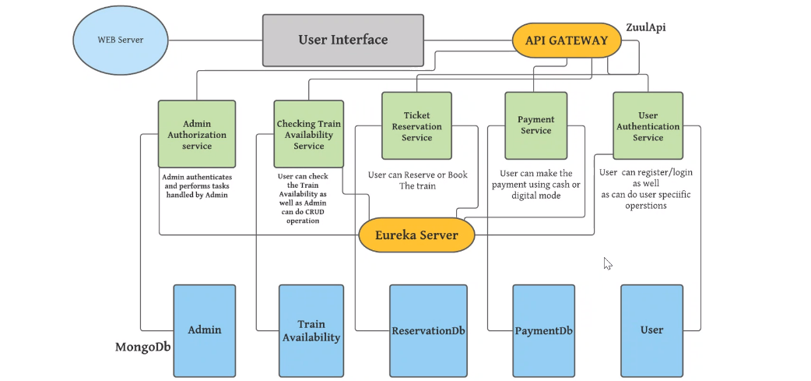







Web-Server
Web-Server
User Interface
(React)
User Interface
(React)
API-Gateway
JWT
API-Gateway
JWT
Admin
(8084)
Admin/User
(8086)
Reservation
(8082)
User
(8083)
Order
(8081)
Washer
(8082)
Payment
(9004)
Inventory
(8083)
Room
(8081)
Staff
(8084)
Admin
User
Order
User
Inventory
Room
Washer
Payment
Staff
Book

Slide 5

/sigin
Post
API
G
A
T
E
W
A
y
/signup
Post
/api/auth
API
CALL
/roles
Post
Auth/Admin/User
Auth/Admin/user
/user
Get
/admin
Get
Auth/Admin/user SOLUTION DIAGRAM
5
5
5

Slide 6
/{id}
Get
API
G
A
T
E
W
A
y
API
CALL
/save
Post
/api/
bookings
Booking DB
/{id}
Put
Reservation
/{id}
Delete
BOOK SOLUTION DIAGRAM
6
6
6

Slide 7
/get/{id}
Get
API
G
A
T
E
W
A
y
/put/{id}
Put
API
CALL
/api/staff
/delete/{id}
Delete
Staff DB
/getAll
Staff
Get
/save
Post
STAFF SOLUTION DIAGRAM
7
7
7

Slide 8

getgg
/{roomType}/{roomService}
Get
API
G
A
T
E
W
A
y
/getAll
Get
API
CALL
/api/rooms
/get/{id}
Get
/save
Room DB
Post
Room
/put/{id}
Put
/delete{id}
Delete
ROOM SOLUTION DIAGRAM
8
8
8

Slide 9
getgg
/GetAll
Get
API
G
A
T
E
W
A
y
/save
Post
/api/
inventory
API
CALL
/get/{id}
Get
Inventory DB
/put/{id}
Put
Inventroy
/delete{id}
Delete
INVENTORY SOLUTION DIAGRAM
9
9
9

Slide 10
TECHNOLOGY STACK
Back End :
Spring Boot - Microservices
Eureka Server
Spring Cloud API Gateway
Swagger
RazorPay payment Gateway
MongoDB
Front End:
React Js
Hooks
Html , CSS
Bootstrap

Slide 11
Thank you

